Slide 1


IPL ANALYSIS
POWER BI PROJECT
Y Jaya Kushal

Slide 2


DATA SET
1. Fact Bowling
o Columns Description:
▪ match_id: Unique identifier for the match. ▪ match: Description or name of the match. ▪ bowlingTeam: Name of the team that is bowling. ▪ bowlerName: Name of the bowler. ▪ overs: Number of overs bowled by the bowler. ▪ maiden: Number of maiden overs bowled. ▪ runs: Runs conceded by the bowler. ▪ wickets: Wickets taken by the bowler. ▪ economy: Economy rate of the bowler. ▪ 0s: Number of dot balls bowled. ▪ 4s: Number of fours conceded. ▪ 6s: Number of sixes conceded. ▪ wides: Number of wide balls bowled. ▪ noBalls: Number of no balls bowled.
2. Fact Batting Summary
o Columns Description:
▪ match_id: Unique identifier for the match. ▪ match: Description or name of the match. ▪ teamInnings: The team batting in the innings. ▪ battingPos: Batting position of the player. ▪ batsmanName: Name of the batsman. ▪ out/not_out: Whether the batsman was out or not out. ▪ runs: Runs scored by the batsman. ▪ balls: Balls faced by the batsman. ▪ 4s: Number of fours hit. ▪ 6s: Number of sixes hit. ▪ SR: Strike rate of the batsman.

Slide 3

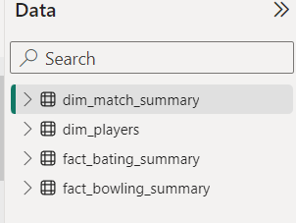
DATA SET
3. Dim Player
o Columns Description:
▪ name: Name of the player.
▪ team: Team the player belongs to.
▪ battingStyle: Batting style of the player (e.g., Right-hand bat).
▪ bowlingStyle: Bowling style of the player (e.g., Right-arm fast).
▪ playingRole: Role of the player (e.g., Batsman, Bowler).
4. Dim Match Summary
o Columns Description:
▪ team1: Name of the first team.
▪ team2: Name of the second team.
▪ winner: Winner of the match.
▪ margin: Margin of victory.
▪ matchDate: Date of the match.
▪ match_id: Unique identifier for the match.

Slide 4
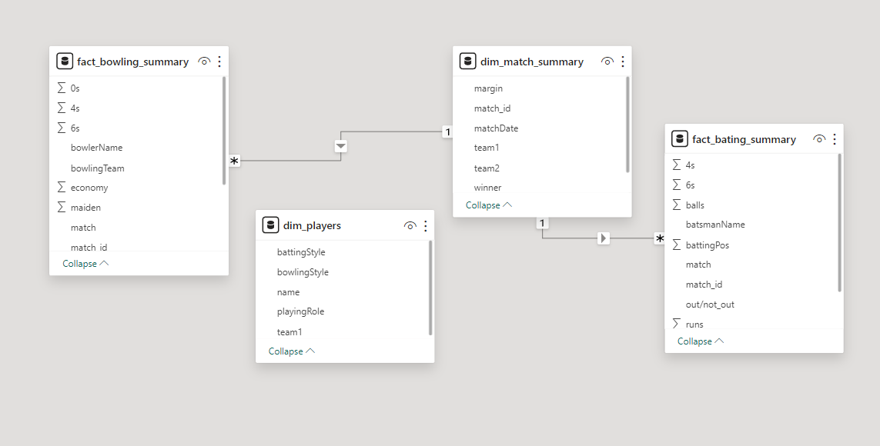
MODEL VIEW

Slide 5
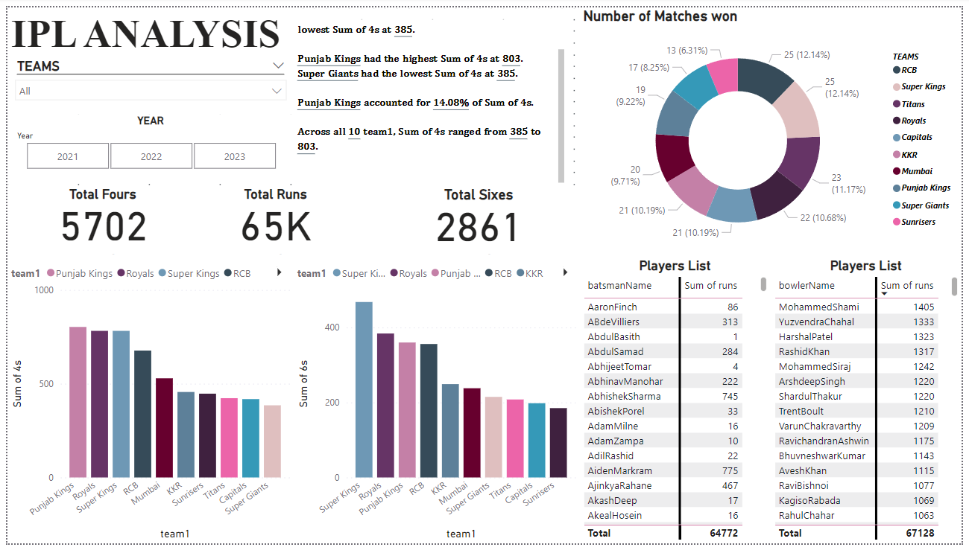

Slide 6
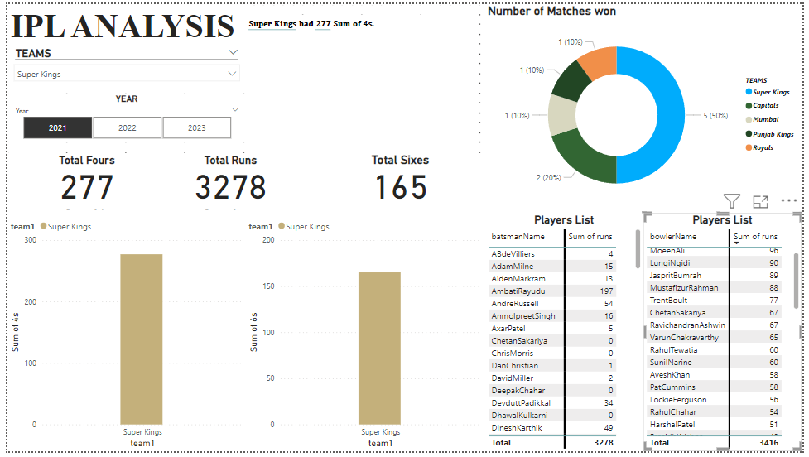

Slide 7
